Slide 1

Flask Fun
Intro to Web Servers
by Thomas Kercheval, Chris Johnston
&& The ACM@UWB
Notes:
Hello everyone and welcome to the “Introduction to Web Servers” presentation.

Slide 2

Before We Begin
Intended audience:
Beginners (no server dev. exp. needed)
Folks who can read basic Python*
Recommended software:
Python3
Git
Scan QR code to find sample code
https://bit.ly/2OLGuX6
( https://github.com/UWB-ACM/flask-barebones )
*If you don’t know Python, that’s okay!
Notes:
No experience required
Nice if you know python and git
Open our sample project at that link or QR code
Before we begin I have a few things to cover:
First, everyone scan that QR code, or navigate to that bit.ly site. This repo contains our example project, which we will be referring to throughout this presentation.
This presentation is intended for beginners, so you don’t need any experience with server development. It will help if you know how to read Python, but that’s not necessary. We recommend using Python3 and Git, but you can always use whatever you like.

Slide 3
Before We Begin
As with all of the other presentation materials today, you can download these slides and read more at
http://docs.uwbhacks.com/
If you have questions, I’ll be happy to answer them at the end of the slides.
Please raise your hand if you have questions.
Notes:
Slides are on the docs
I’ll have time for Q&A at the end
Raise your hand
Also, these slides are on the hackathon documentation. Feel free to download these to follow along, check back later, or for your future reference.

Slide 4
Before We Begin
This presentation will focus on Flask, a Python web service microframework. Many of the same concepts exist in other frameworks, available in other languages and tech stacks.
C#: ASP.NET
Java: Spring
C++: CppCMS
Node.JS: HTTP Module
Go: net/http
Python: Flask, Django
And many others that I can’t list here
Notes:
Equivalent libraries for other languages exist
Concepts transfer over well
Python is ez and fast to write, so it’s good for hackathons
On that note, we are focusing on a specific library for Python.
Many of the concepts that we are going to cover today exist in other web frameworks, so I encourage you to take a look at those if there is a language you are more familiar with.
We like Flask for a number of reasons:
Python is an easy to understand language, fast to write
It works really well, and is easy to understand.

Slide 5

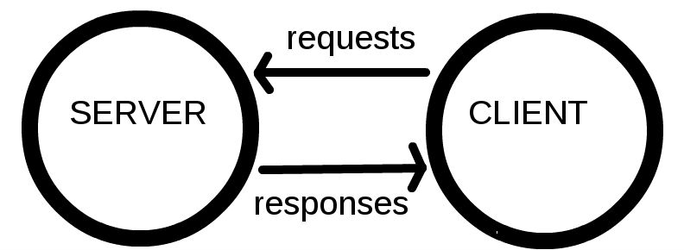
What is a Web Server?
Web servers serve web content!
“Hosts” HTML & media
HTML, CSS, JS, media
JSON/XML APIs
Enables communication
among services
Responds to client requests using HTTP
Notes:
Web server = a server that hosts web content
Serves html + other media for your browser
APIs = Application Programming Interface, enables communication among services
Hyper Text Transfer Protocol to respond to clients
What is a web server?
A web server is any server that serves web content. These are the servers that your web browser will connect to, which send you back the web pages you look at.
These servers host HTML and other media.
If you attended the Intro to HTML workshop, you’ll know that HTML, CSS, and JS are the three formats used by your web browser. In addition to this, web servers can host any other type of file, including images, videos, PDFs, etc.
These servers can also host APIs (which stands for Application Programming Interface) which accept requests from clients and generally can return JSON or XML.
Web servers allow for communication among services. For example, you might have a chat client which connects to a web server to download the latest messages, or to get information about a user.
Web servers use HTTP (which is Hyper Text Transfer Protocol) to respond to clients. We’ll talk more about HTTP later.

Slide 6


What is Flask?
Flask is a Web Microframework
Written in Python
Simple!
Efficient (Fast)
Use it to build web applications!
Notes:
Flask = Web Microframework
Simple, fast
Netflix, Reddit, Uber, Samsung => production ready
So what is Flask, anyways?
Flask is a Web Microframework. It’s written in Python, it’s really simple, and it’s really fast.
You can use Flask to build web applications. Netflix, Reddit, Uber, and Samsung all use Flask, so it’s definitely production ready.

Slide 7

What is Flask?
Why would I want to use a “micro” framework?
http://flask.pocoo.org/docs/1.0/foreword/#what-does-micro-mean
“Micro” = simple and extensible.
Provides only it’s own functionality
Extensible using other libraries
No point in redoing the work of other libraries.
Notes:
“Micro” = simple and extensible
Only is an app framework
Doesn’t reinvent the wheel, doesn’t do rate limits or database connections
So why it it called a “Micro” framework?
It’s called a Micro framework because it’s simple and extensible.
Flask only provides the functionality that it promises, a web app framework and not a server.
You can extend the functionality using third party libraries. Some extensions can provide utility like more robust hosting, rate limiting, and database connections.

Slide 8
Routes (API Endpoints)
Routes are hierarchical sections of a website
Full path specifies resource requested from server
PROTOCOL :: Rules that govern communication
HOST_NAME :: Name of service (e.g., google.com)
ROUTE :: Specific page on website/service
SUB_ROUTE :: Page “deeper” in the hierarchy
URL*
URL Expansion
Annotated URL Parts
http://flask.pocoo.org/community/poweredby
http ://flask.pocoo.org /community /poweredby
PROTOCOL ://HOST_NAME /ROUTE /SUB_ROUTE
*URL – Uniform Resource Locator
Notes:
Routes = way to acces info on website
URL = Uniform Resource Locator = web addresses
Number of parts: protocol hostname route
Protocol: how client talks to server (HTTP, HTTPS, FTP, IRC)
Hostname: where to find the server
Route: what on the server to access. Can contain sub routes.
When talking about web servers, it’s important to understand routes. Routes define a way to access information on a website, through a hierarchy.
You may already be familiar with URLs or Uniform Resource Locators. These are also known as web addresses.
URLs are composed of a number of parts:
The protocol: which is how the client talks to the server. There’s HTTP, but other types can include HTTPS, FTP, IRC.
The hostname defines where the server can be reached.
The route refers to what on the server is being accessed. If you go to google dot com, you won’t see a route. The default route is referred to as root, which is represented by a single slash.
Routes can be nested with other routes, which you may have seen in URLs before.

Slide 9
HTTP Methods
The HyperText Transfer Protocol (HTTP) has several methods of operation. Here are some of the most common ones, with their expected behavior.
GET - Fetch specified resource
POST - Submit information to resource
DELETE - Deletes specified resource
… and more!
HTTP Request format (including URL):
METHOD PROTOCOL://HOST_NAME/ROUTE/SUB_ROUTE
E.g., GET http://127.0.0.1:5000/static/index.html
Notes:
HTTP sends data to web server
REST = representational State Transfer (out of scope)
GET gets data, used by browser
POST sends data, like login data.
DELETE can delete data
Uwbhacks example
The web is built on HTTP. HTTP is a protocol for sending some data to a web server at a specific route.
With each of these routes, you can perform actions, or methods on them. I don’t have the time to explain REST (which is representational state transfer) in full today, but using these methods on different routes you can access and modify information on the server.
There are more than just these three methods.
The GET method is the easiest to understand. Your browser uses GET when requesting web pages from servers. You can see this in your browser debugger, give it a try.
POST is similar to GET, except it allows for sending a message body with the request. For example, a POST request can include some JSON.
This is commonly seen with user login forms. You may have experienced a browser asking if you would want to resend a request, it’s asking if you want to re-send a POST.
DELETE is pretty self explanatory. In REST APIs, DELETE can delete a resource. This ony works if the server supports this functionality, which could be restricted based on your authorization.
Here you can see that our browser is GET-ing the index page hosted on our server.
IF I CAN, OPEN THE DEBUGGER AND AN EXAMPLE SITE

Slide 10
“PaaS” Example Project
We made an example project which contains the code that we are going to refer to.
https://bit.ly/2OLGuX6
https://github.com/UWB-ACM/flask-barebones
Notes:
Puns As a Service
Example applicatoin
Uses flask, on github, made in python
We have a sample Flask application that we’ve made. You can find the source code here, using this QR code.
It’s called Paas, or Puns as a Service.
Wait for people to look at it.
It’s written in Python and hosted on GitHub.

Slide 11

Setup Project
Clone project from GitHub
git clone https://github.com/UWB-ACM/flask-barebones.git
Enter project repo
cd flask-barebones/
Install dependencies
python3 -m pip install -r requirements.txt
Notes:
Clone
Cd
install
If you are looking at these slides later, and would like to follow along, you can follow these steps.
WE ARE NOT GOING TO WAIT FOR PEOPLE TO FOLLOW ALONG
First, clone the repo using Git.
Then, navigate to the repo and install the dependencies, you may require root.

Slide 12
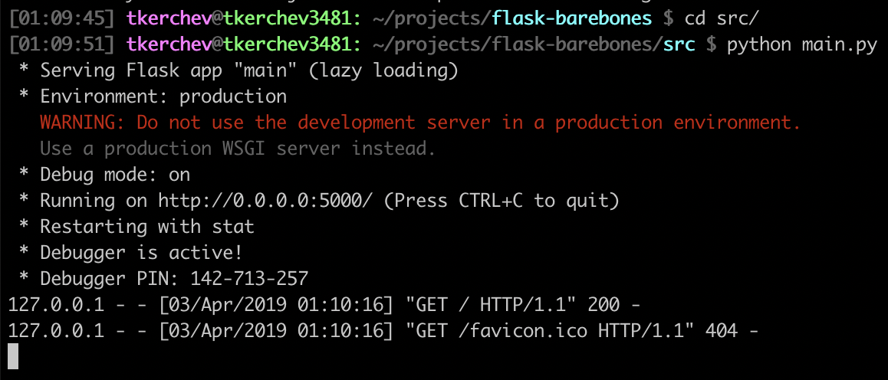
Launching Dev Server
Enter src/ directory
cd src/
Launch dev server
python3 main.py
Visit 127.0.0.1:5000/
Notes:
Cd
Run
This is the dev server, on localhost
Starting our development server is easy, first you navigate to the directory containing our code, then start it with this command.

Slide 13
Live Demo
Try to use this ngrok link for the server running on my laptop:
TODO
Else, use: http://paas.uwbhacks.com/
Notes:
Start the dev server
Start ngrok (we have a page in the docs about it)
Also paas.uwbhacks.com is another host
Let’s see if my live demo works.
Make sure this is ready beforehand.
Start the server, start ngrok.
Share the ngrok url and show the window to them.
Wait for people to see it and to start poking around.

Slide 14
Defining a Route (in Flask)
from flask import Flask
app = Flask(__name__)
@app.route('/test')
def testing():
return 'Hello, Flask!'
if __name__ == '__main__':
app.run(debug=True,
host='0.0.0.0')
Import web microframework
Get WSGI application instance
Define “test” route as a simple hello world
This just returns plain text, not HTML.
Start Dev server, when script is run directly.
Notes:
You can follow along in main.py
App.route decorator defines the route
/test returns hello flask
Test this on the site
If you have the repo open, you can follow along. Open the file called main.py
This is how we define a route in Flask.
First, we perform some setup that lets our application run, and define a main.
The function hello world defines the test endpoint. This is shown when users go to the slash test route on our site.
We can also assign multiple routes, by using that function decorator more than once.
So, when someone sends any HTTP to our website, they’ll see “hello, flask!”
If ngrok is working, please try this now.

Slide 15

Serving Static Content
Static content…
Does not change based on behavior
Sending files to client on request
HTML, images, videos
Efficient!*
No additional compute required
*Static content is best served upstream (e.g., w/Nginx, more later)
Notes:
Static content doesn’t change
As seen on uwbhacks.com
HTML, CSS, JS, Images, Vidoes
Efficient because of caching, doesn’t require modification
So you may be wondering, how could I use my Flask website to serve HTML pages that I already wrote, images, or videos?
You’ll want static content.
Static content is any content that does not change based on the user’s behavior. For example, the uwb hacks website is all static content, as the files that you see on that website don’t change.
Css, js, images, and videos are all static content.
Serving static content is really efficient. Why?
You don’t need to modify anything whenever a request is made. In addition, you can use caching to offload the work of your main server on caching servers.

Slide 16
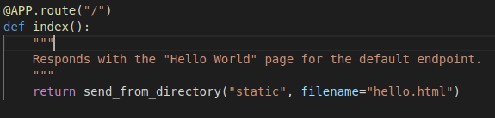
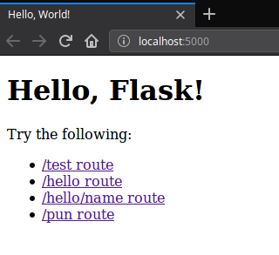
Serving Static Content (cont…)
src/main.py
Choose a directory to serve from
I chose src/static/
Create a HTML file
e.g., src/static/hello.html
Setup a route to serve static content
Start the dev server
Request resource from browser –>
Notes:
Flask can serve static files
Assumes static files are under static dir
Send_from_directory method
Root endpoint ‘/’ -> hello.html
So we can do this with flask.
Flask assumes that your static content is under the static directory.
You can create files under this directory.
Using the send_from_directory method, you can have your endpoints return files from any directory that you specify.
In this case, we set the root endpoint, which is the default for your web browser, to send the file hello.html.

Slide 17

Serving Dynamic Content
Dynamic content changes
based on user behavior!
Examples of dynamic content...
User account information
Live weather information
Content that requires a database call
Notes:
Dynamic content changes
Can populate data from database
http://www.compjour.org/lessons/flask-single-page/multiple-dynamic-routes-in-flask/
So static content never changes, and Dynamic content can. It can be modified from user behavior, including data from a database.
You can use dynamic content for:
User account information
Showing the weather on a weather app
Showing some data that is stored in a database.

Slide 18
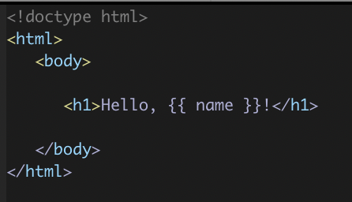
Serving Dynamic Content (cont…)
src/templates/name.html
HTML Templates in Flask
Insert {{ variables }} into HTML
Jinja2 - Template Engine
Rendered at runtime
Create templates/ directory
Create HTML file, with variable “{{ name }}“
Notes:
Flask uses Templates
Write the HTML, then fill in variables with values
Flask calls Dynamic content Templates.
This is because you create a template website, with all of the HTML already made. Then, upon serving the page you can insert the data you want before sending it to the client.
Flask comes with a template engine, called Jinja2. It’s integrated into flask, so you don’t have to do any extra work to get it working.
Try this out now, there’s a link on the index page.

Slide 19
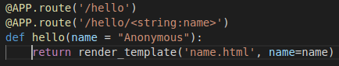
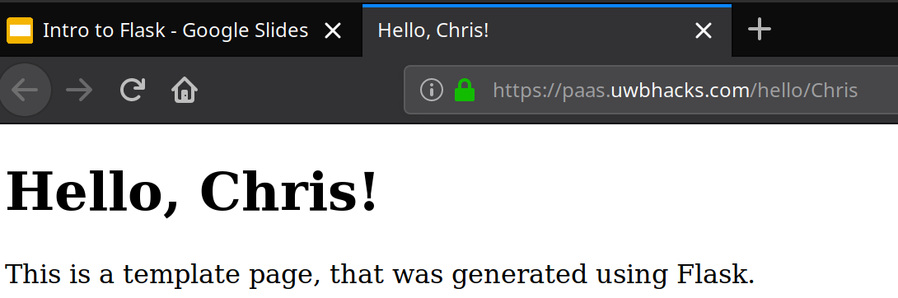
Serving Dynamic Content (cont………...…)
src/main.py
Setup route to accept a parameter
Render HTML file
Flask will look in /templates dir
Pass in keyword arguments
Keyword matches var name in HTML
Start dev server
Request resource from browser –>
Notes:
Render_template can render templates
We supply the name parameter to insert into the page
We can define more than one route
Routes can contain parameters, which can be validated
Try it now on the site
Using these steps, we can serve dynamic content. Again, start your server and try it in the browser.
Notice here that we defined two routes for the same method. You can totally do that.
The second route has a parameter defined, called name which is a string. Flask routes can check the type of inputs, and validate them for you. Less work for you that way!
This route paramter sets the name parameter of the method, which is sent to the name.html template. The client will then see this when they load the page.
Try this! Go to the ngrok page and modify the route of the URL to your own name.

Slide 20


Deploying Your Application
Why do I need another server?
Flask is NOT a web server
Flask is an app microframework
Flask’s built-in “dev” server is NOT meant
to scale to production
Upstream servers typically handle
connections and HTTP validation
Static content is best served by
upstream servers
Notes:
Flask is a framework not a server
Comes with a dev server
Not good enough for prod, like many connections and validation
Web servers handle static content better
So let’s talk about how we deploy our application.
In the context of a Hackathon, or for a demo (like this one) something like ngrok works perfectly fine.
We can use the development server that is provided to us from Flask.
However, for real world scenarios, we need something more robust.
Remember that Flask is not a web server, it’s an app microframework. There are web server specific things that Flask cannot do, that web servers need to be able to do.
Flask’s dev server does not scale to fit the needs of production.
Upstream servers can be used to manage many connections and HTTP validation. These can also handle stuff like HTTPS.
HTTPS is really important for ensuring the saftey and integrity of your user’s data.

Slide 21
Deploying Your Application
From the flask docs:
While lightweight and easy to use, Flask’s built-in server is not suitable for production as it doesn’t scale well and by default serves only one request at a time.
Notes:
This quote from the flask docs explains things very well.

Slide 22
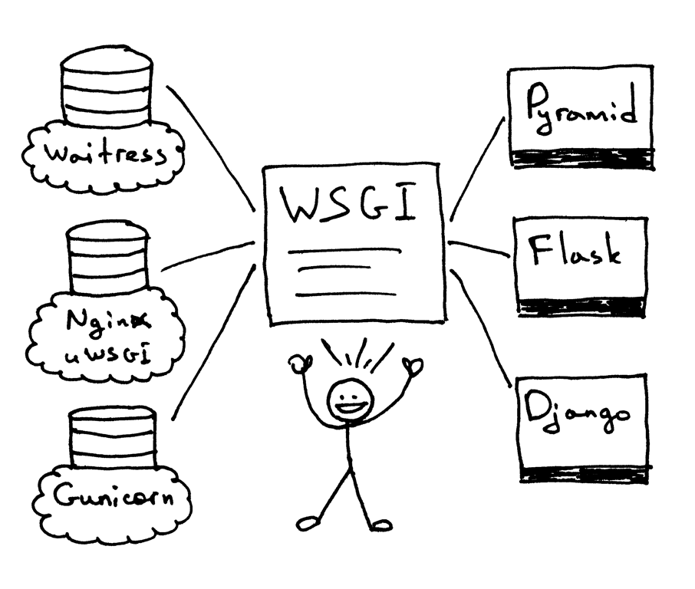
WSGI
Web Server Gateway Interface
Interface for upstream servers
to talk to Python frameworks
Enables separation of concerns
for app and server devs
Defined in PEP 3333
Notes:
WSGI = Web Server Gateway Interface
Connects upstream web servers to app frameworks
Separation of concerns and inter compatibility = freedom of choice
If you are creating a new production-ready python application, you may have some reason to require a specific type of server, or a specific app framework.
WSGI is a standard, accepted by both web servers and app frameworks. It standardizes the way that these can talk to each other, so that they can retain compatibility.

Slide 23
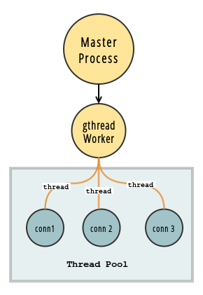

Gunicorn Deployment
Gunicorn is a WSGI compliant HTTP server
Listens for client requests and runs your Flask app
Helps handle multiple connections
Pre-fork worker model
Thread per worker
Use gunicorn with sample project!
Run ./gunicorn_start.sh
Notes:
Gunicorn is WSGI complaint
Multiple connections
1 thread per worker
Included script to start it in repo
Gunicorn is a WSGI-compliant HTTP server.
Unlike the Flask dev server, it can handle multiple connections at the same time. The sample application includes a script to run the app using gunicorn.

Slide 24

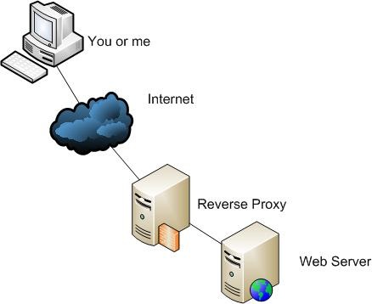
Nginx Deployment
Nginx is a reverse proxy! (yxorp)
A reverse proxy is an upstream server
Serves static content VERY efficiently
Handles HTTP request validation
Stops malformed/malicious HTTP
SSL/TLS termination
Not included in sample Flask project
Try it yourself!
Notes:
Nginx is a web server, and a reverse proxy
Reverse proxy redirects to back-end server
Load balancing, caching, and better security
Nginx is called a reverse proxy. A reverse proxy is behind a firewall of a network, and redirects requests from the client to a back-end server.
This can do fancy things like load balancing, caching, and improves security.

Slide 25
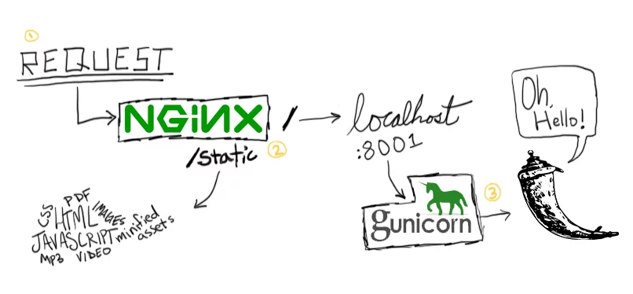
Gunicorn + Nginx
Use both gunicorn and Nginx, for great justice!
Nginx serves static
gunicorn implements WSGI
Flask handles app logic
Do it and your friends WILL think you’re cool
Notes:
Combine gunicorn and nginx
You can combine gunicorn and nginx, so that Nginx serves your static content, Gunicorn implements WSGI, and your flask app handles the logic.

Slide 26

Gunicorn + Nginx
Notes:
Setting these up might be hard
As you may be thinking, getting all of these three components to play nice with each other might be a hassle.
What if in the future you want to deploy to several servers at once? You could use a complicated setup script to install and configure all of these.

Slide 27
Hosting using Docker
Configuring many separate services can be difficult to deploy. Containers can make setup and deployment easier.
https://github.com/tiangolo/uwsgi-nginx-flask-docker
Notes:
Containers can make this easier
Common image uses UWSGI, nginx and flask for docker
Minimal extra configuration
Robust and scalable with less effort
Big topic outside of scope
You can use containers and to make deploying easier. One really popular one uses UWSGI for the server, NGINX, and Flask in Docker to set everything up. It only requires minimal extra configuration, and you don’t have to manually start everything all at once.
This way, you can get a robust and scalable server with minimal effort. You don’t really need to understand exactly how everything goes together, but it can really help.
Containers and Docker are a huge topic outside of this scope, so we won’t cover that today.

Slide 28



Next Steps - Cloud Deployment
Are you interested in learning about Cloud technology? Now’s a great time to try it and learn! You can deploy Flask applications with AWS Elastic Beanstalk or Azure App Services.
Free when you use student credits! (GitHub Education Pack)
You can also deploy to any virtual machine, including those hosted on AWS, Azure, Google Cloud Platform, DigitalOcean, etc. ...
Notes:
Hackathons are great to learn about cloud platforms
Gh student pack free credit
Automatic scaling using flask, among others. AWS elastic beanstalk, Azure app services
Pricey, check pricing first.
Can use cheaper virtual machine.
For those of you that are curious, and are looking to learn about cloud platforms like AWS and Azure, hackathons are a great way to explore new technologies and learn along the way.
With the GitHub student pack, all of you should have access to free student credits. Just make sure to stop your servers after today, so you don’t get billed.
AWS and Azure both offer managed platforms which can automatically scale your application, and they both support flask, among other app frameworks. AWS’ is called Elastic Beanstalk, and Azure has App Services.
These can get somewhat pricey, so I recommend look closely at the pricing details before you get started.
In addition, you can also always deploy to a virtual machine, or other remote server. Again, AWS, Azure, and Google Cloud Platform are all good options, but you can also use other providers like Digital Ocean and linode.

Slide 29
Questions?
Comments?
Concerns?
Anything you would like me to explain in the example application?
Notes:
So that’s all for today. Any questions, comments, or concerns?
Also, feel free to keep poking around the example application. Is there anything there you would like me to explain?

Slide 30
References
The Flask documentation is great!
http://flask.pocoo.org/docs/1.0/
Notes:
As always, if you get stuck and need more help than we can provide, the Flask documentation is great! Go check it out!

